Slide 1
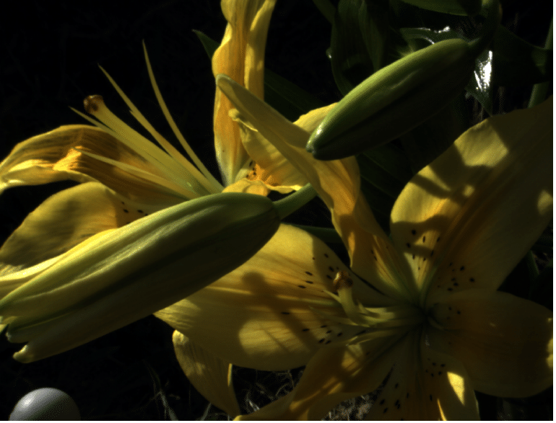
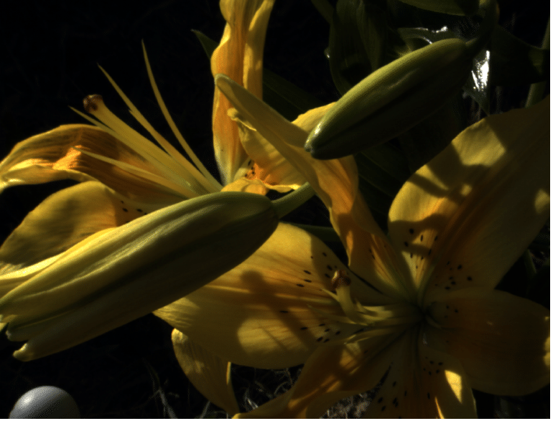
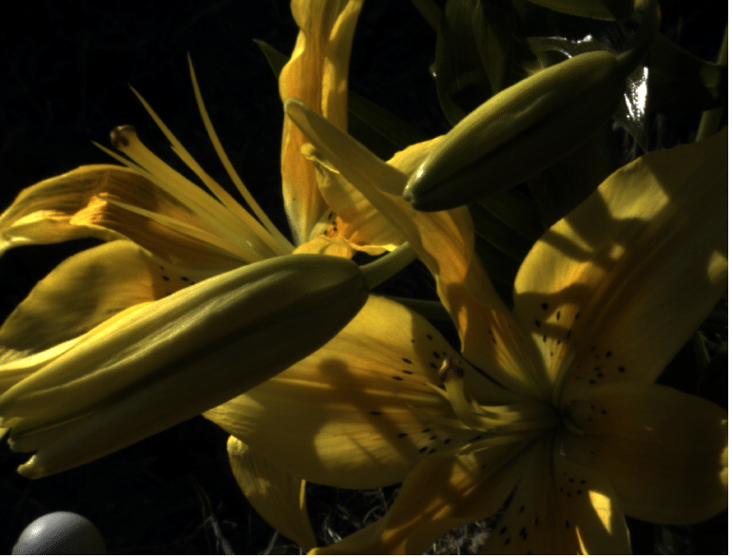
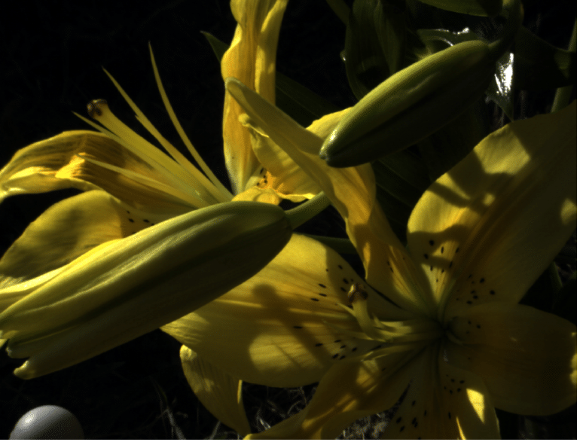








Camera: CANON 5D
CIE Standard Illuminant A
CIE Standard Illuminant D65
Fluorescent F1
Fluorescent F2
Fluorescent F3
Fluorescent F4
Fluorescent F5
Fluorescent F6
Fluorescent F7
Fluorescent F8
Fluorescent F9
Fluorescent F10

Slide 2
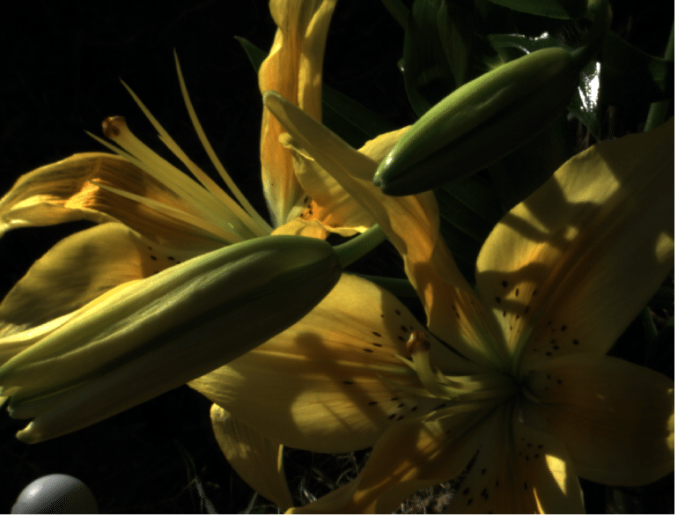
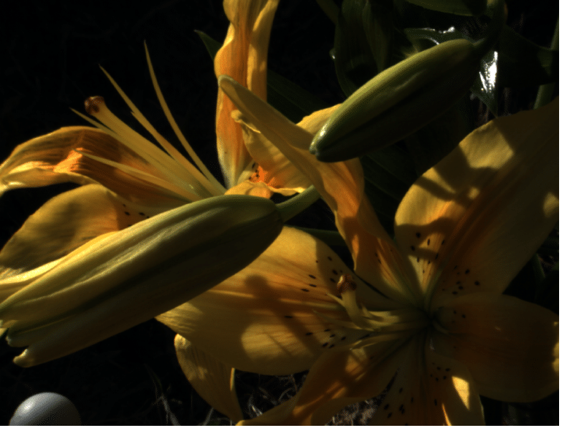

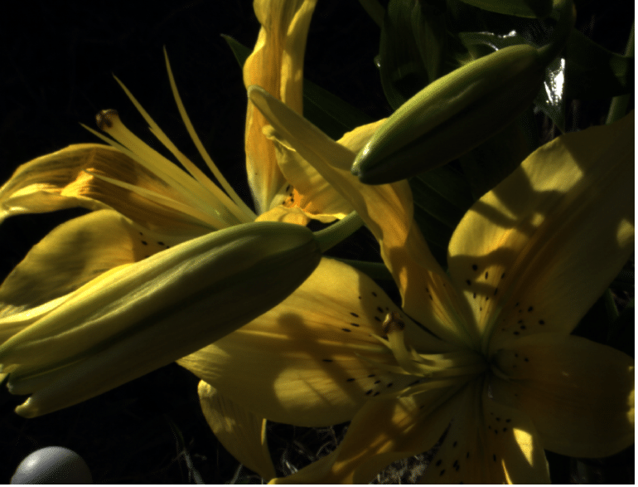








Camera: NIKON D1X
CIE Standard Illuminant A
CIE Standard Illuminant D65
Fluorescent F1
Fluorescent F2
Fluorescent F3
Fluorescent F4
Fluorescent F5
Fluorescent F6
Fluorescent F7
Fluorescent F8
Fluorescent F9
Fluorescent F10

